Slide 1



Coffee Shop Sales
View in Power BI
Last data refresh:
8/30/2024 7:02:52 AM UTC
Downloaded at:
8/30/2024 7:06:23 AM UTC

Slide 2

Home
Notes:
textbox
No alt text provided
image
No alt text provided
pageNavigator
No alt text provided
actionButton
No alt text provided
textbox
No alt text provided
image
No alt text provided
image
No alt text provided
image
No alt text provided

Slide 3
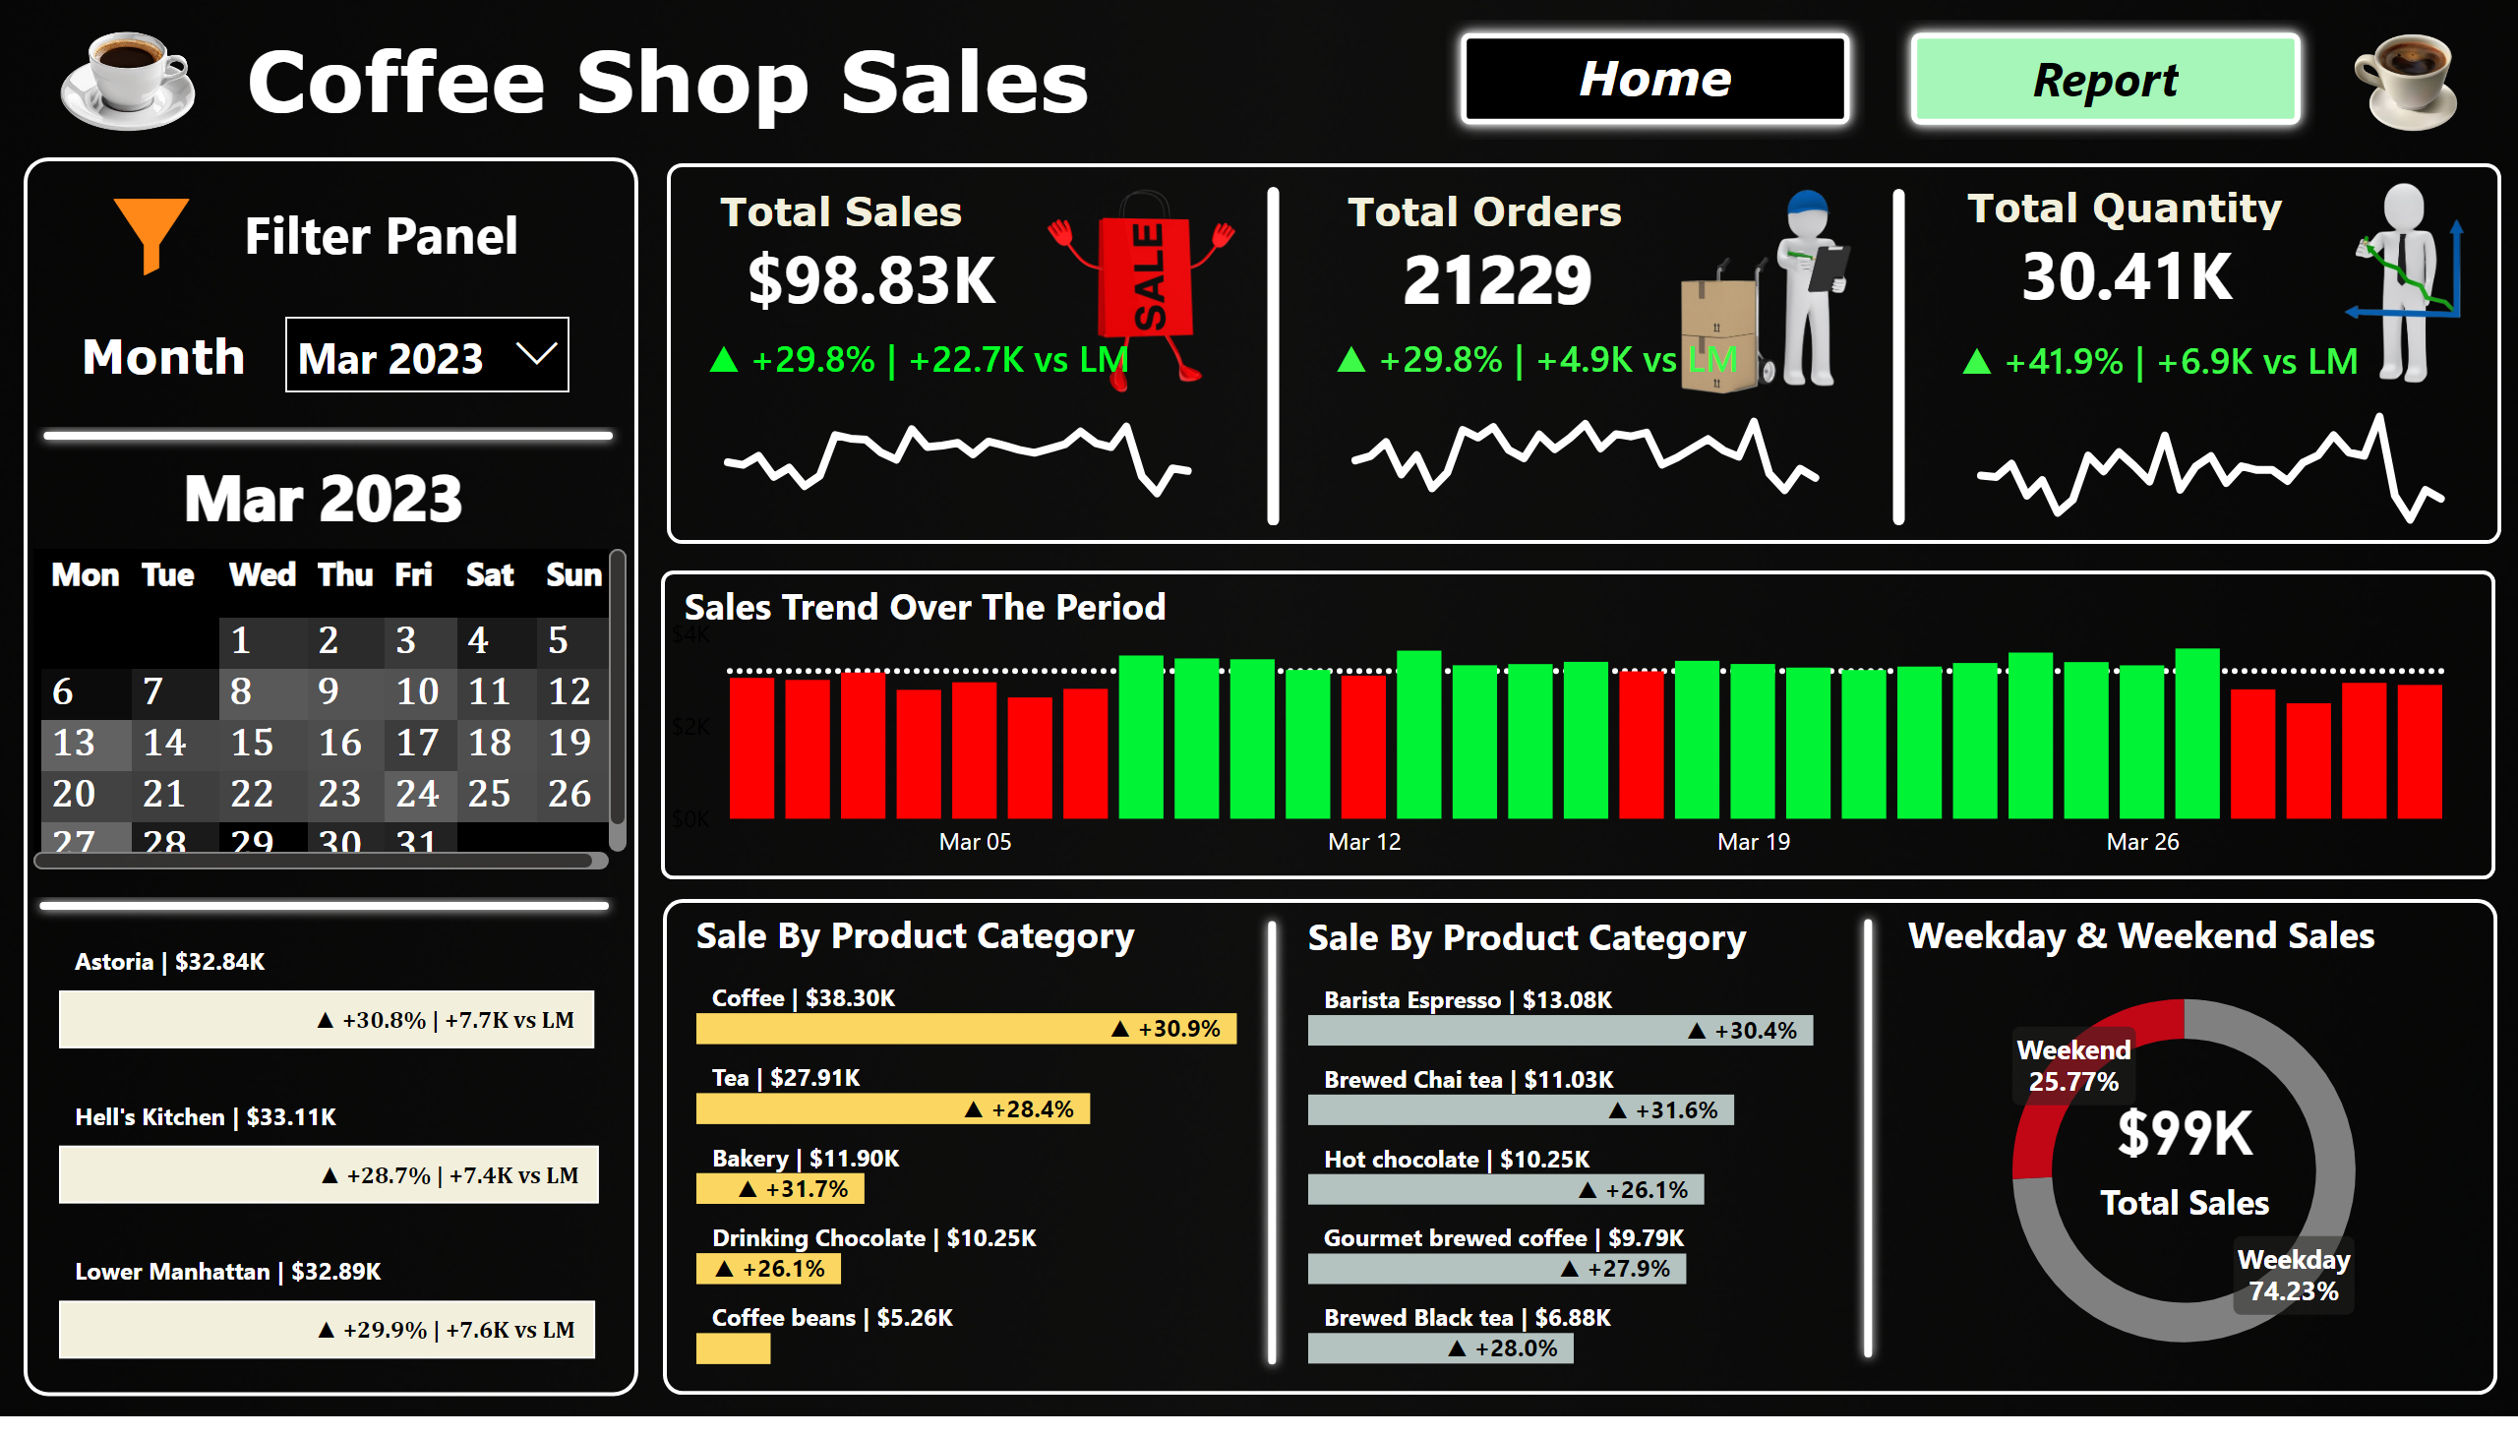
Report
Notes:
shape
No alt text provided
shape
No alt text provided
shape
No alt text provided
shape
No alt text provided
textbox
No alt text provided
Total Sales
No alt text provided
▲ +29.8% | +22.7K vs LM
No alt text provided
slicer
No alt text provided
pivotTable
No alt text provided
card
No alt text provided
shape
No alt text provided
shape
No alt text provided
donutChart
No alt text provided
Total Sales
No alt text provided
Sales Trend Over The Period
No alt text provided
clusteredBarChart
No alt text provided
Sale By Product Category
No alt text provided
Sale By Product Category
No alt text provided
textbox
No alt text provided
pageNavigator
No alt text provided
image
No alt text provided
textbox
No alt text provided
image
No alt text provided
textbox
No alt text provided
Total Orders
No alt text provided
shape
No alt text provided
▲ +29.8% | +4.9K vs LM
No alt text provided
Total Quantity
No alt text provided
shape
No alt text provided
▲ +41.9% | +6.9K vs LM
No alt text provided
textbox
No alt text provided
shape
No alt text provided
shape
No alt text provided
image
No alt text provided
image
No alt text provided
image
No alt text provided
image
No alt text provided

Slide 4
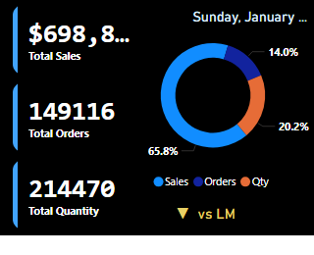
ToolTip For Calender
Notes:
cardVisual
No alt text provided
donutChart
No alt text provided
card
No alt text provided
card
No alt text provided

Slide 5
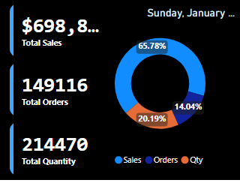
Duplicate of ToolTip For Calender
Notes:
cardVisual
No alt text provided
donutChart
No alt text provided
card
No alt text provided

